Slide 1
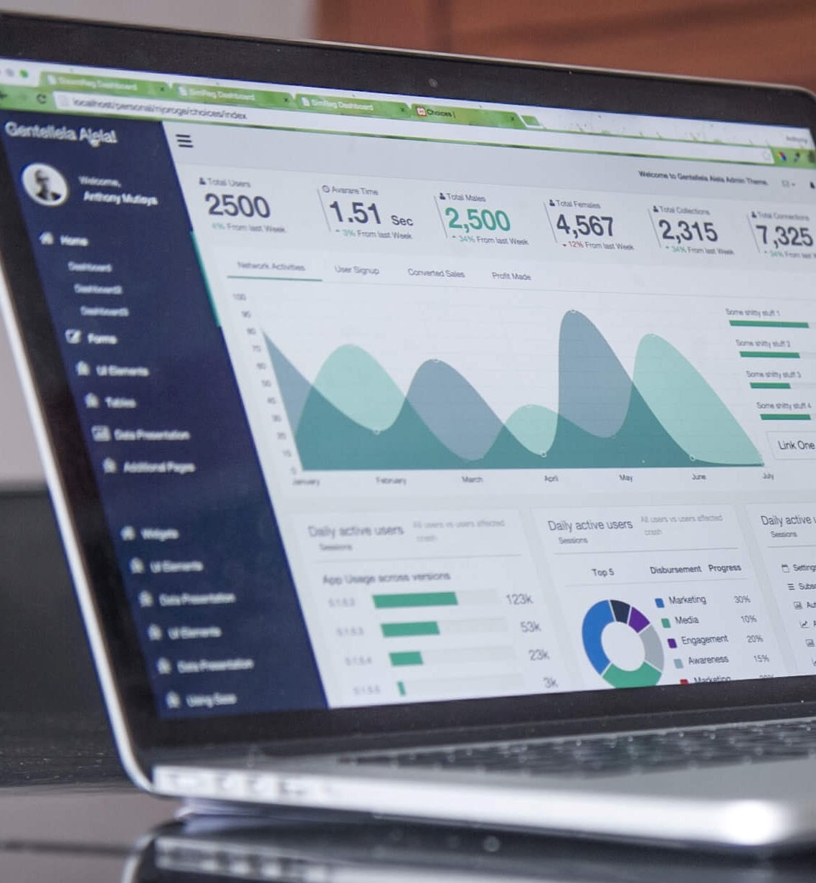

Ingenious
Voice
Biometrics
Solution for SBI Innovate 2022

Slide 2
TABLE OF CONTENTS
Introduction of our application
High-level implementation design
Tools & technologies
Algorithms
GUI Screenshots
Demonstration
Test cases
Why our solution?

Slide 3

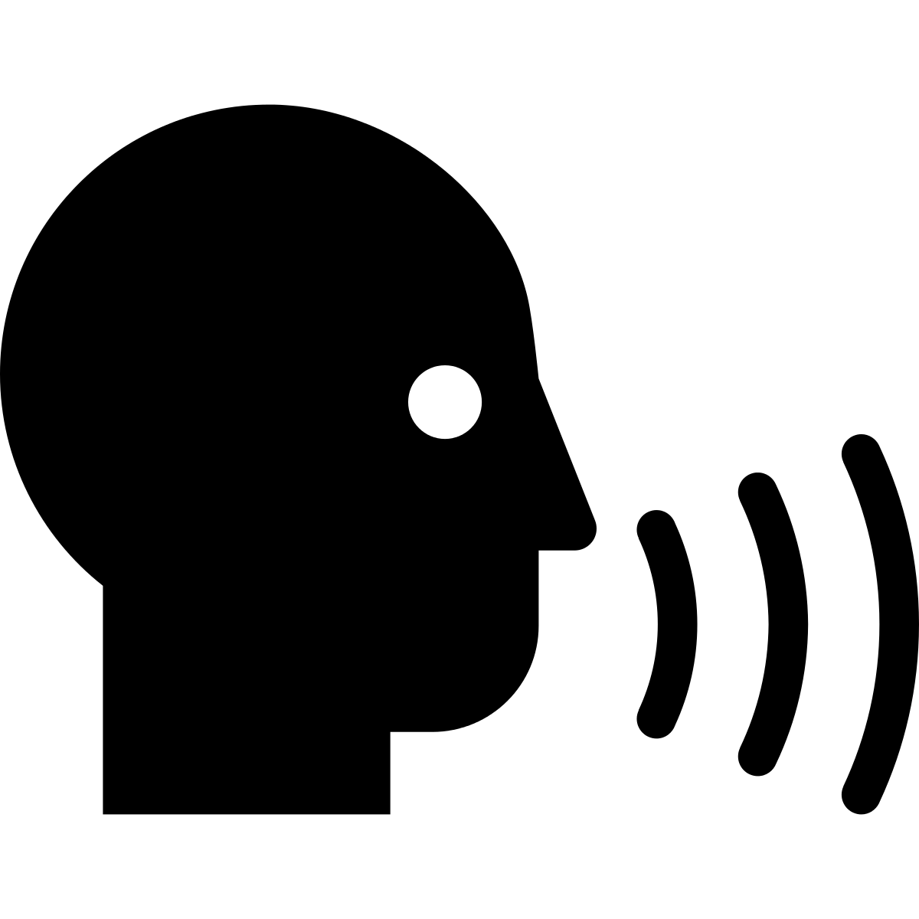
Introduction
We have tried to build an easy to use API for authenticating voice of customers from different applications such as Contact Centers, Chat-bots, Mobile/ Web Applications.
The application takes the Customer’s voice as input
Processing is done to enhance the quality of audio sample collected
Now, the enhanced voice sample is used to create a “Voice-Print” of the customer
Next time, the user interacts with their voice, their “Voice-Print” can be used to authenticate the user

Slide 4

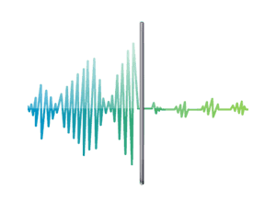


HIGH-LEVEL IMPLEMENTATION DESIGN
Enrollment of User
MFCC
GMM model
MFCC features with combination of Delta are extracted
GMM model of user is generated
Audio files are pre-processed.
Model is stored as pickle file
Pickle file is stored on Azure storage
3 audio WAV files
are uploaded by user
During enrollment, user will be asked for user ID along with the 3 audio WAV files .

Slide 5

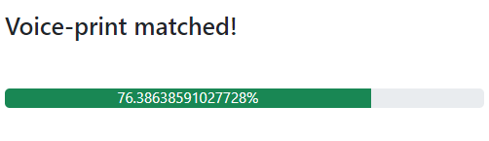

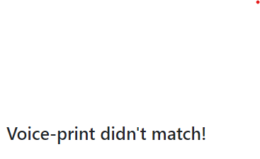
HIGH-LEVEL IMPLEMENTATION DESIGN
During verification, user will be asked for user ID along with the audio WAV file. The features extracted will be compared with the GMM models of enrolled users and on finding the match , score is displayed.
Verification of User
MFCC
WAV file
user
MFCC features with combination of Delta are extracted
Audio files are pre-processed.
[gmm1, gmm2…….gmm(n)]
Unpickling the models and creating list
Pickle files of enrolled users are extracted from Azure Storage
Matched

Slide 6

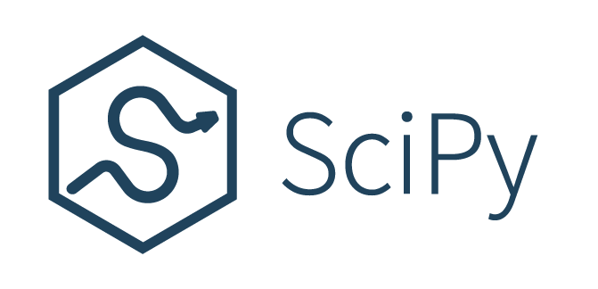


TOOLS & TECHNOLOGIES
Programming language: Python
Framework: Flask for creating REST API
Python libraries used:
Flask==2.1.2
numpy==1.22.4
pydub==0.25.1
python_speech_features==0.6
scikit_learn==1.1.1
scipy==1.8.0
torch==1.11.0
PySoundFile==0.9.0
Storage : Microsoft

Slide 7
ALGORITHMS
Feature extraction: MFCC and delta MFCC
Model: Gaussian Mixture Model (GMM)
Score Metric : Log-likelihood

Slide 8

GUI Screenshots

Slide 9
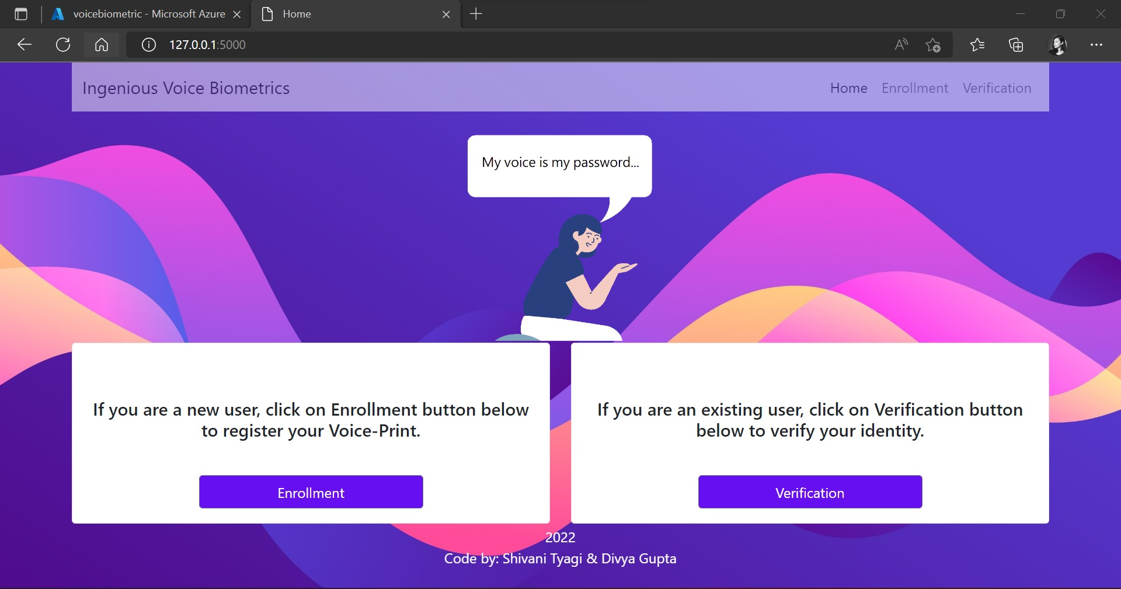
Home Screen

Slide 10
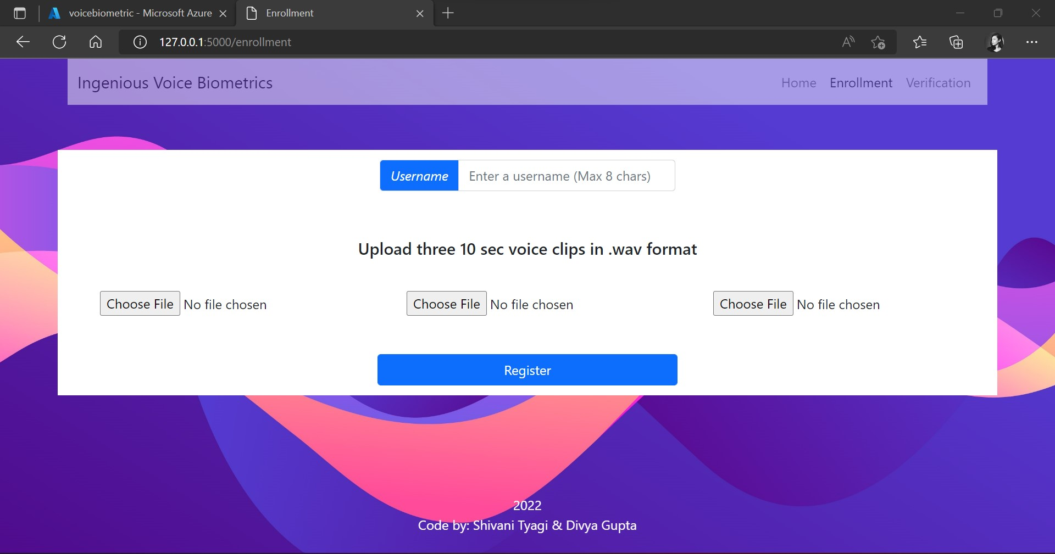
Enrollment Screen

Slide 11

Verification Screen

Slide 12
Demonstration

Slide 13


Slide 14
TEST-CASES
Test Case No. | Test Function | Test Outline | Output
1 | Enrollment | User “A” enrolls (as a new user) | Status: Success
2 | Enrollment | User “A” enrolls (already existing) | Status: Failure Desc: Existing user
3 | Verification | User “A” tries to do verification | Status: Success Score: 79
5 | Verification | User “B” does not exist and tries to do verification. | Status: Failure Desc: User doesn’t exist
6 | Verification | User “B” tries to do verification for user “A” | Status: Failure Desc: Voice print doesn’t match

Slide 15
Why our solution?
Our solution has followed a text-independent approach along with language independent approach and has focused on capturing speaker’s voice characteristics instead of speaker’s words.
1
2
3
Language Independent
Text Independent
Confidence Score
Can be used easily by users speaking different languages
Does not bind user to speak particular words .
Gives match with confidence score

Slide 16

THANK
YOU

